Slide 1
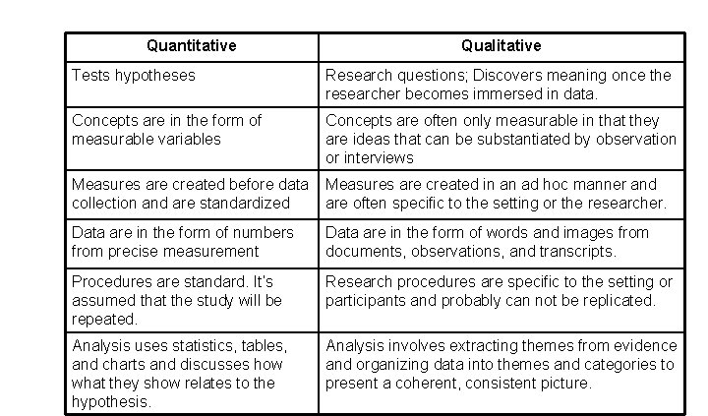
1
Machine learning
Difference between quantitave & qualitative

Slide 2
2
Machine learning
Types of qualitative data type & difference between them
Qualitative data is of two types, namely;
1.Nominal Nominal data is “labeled” or “named” data which can be divided into various groups that do not overlap. Data is not measured or evaluated in this case, it is just assigned to multiple groups. ... Nominal data is considered to be discrete. For example, a dog can be a Labrador or not)
2.Ordinal data; Ordinal data is a categorical, statistical data type where the variables have natural, ordered categories and the distances between the categories are not known. These data exist on an ordinal scale:Examples of ordinal variables include: socio economic status (“low income”,”middle income”,”high income”), education level (“high school”,”BS”,”MS”,”PhD”), income level (“less than 50K”, “50K-100K”, “over 100K”), satisfaction rating (“extremely dislike”, “dislike”, “neutral”, “like”, “extremely like”)

Slide 3
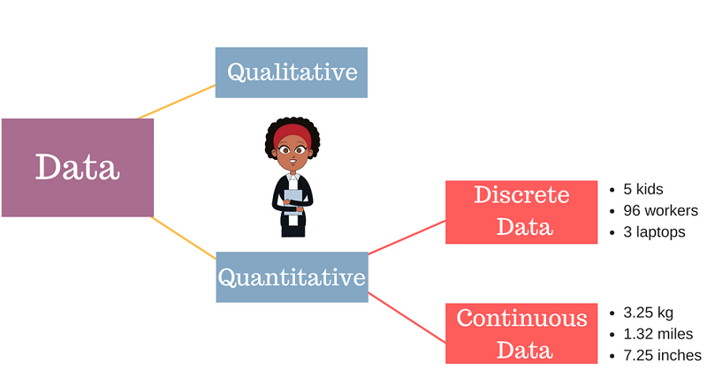
2
Machine learning
Types of quantitative data type & difference between them
There are two types of quantitative data
Continuous(measurements):Continuous data is data that can take any value. Height, weight, temperature and length are all examples of continuous data.
Discrete(counts):can only take certain values. ... This type of data is often represented using tally charts, bar charts or pie charts.

Slide 4
4
Machine learning
Define big data & traditional data
Big data is data that contains greater variety, arriving in increasing volumes and with more velocity. ... Put simply, big data is larger, more complex data sets, especially from new data sources
Traditional data is the structured data which is being majorly maintained by all types of businesses starting from very small to big organizations. In traditional database system a centralized database architecture used to store and maintain the data in a fixed format or fields in a file.

Slide 5
5
Machine learning
Define time series data
Time series data: Time series data is a collection of observations obtained through repeated measurements over time.
Time series data can be useful for:
Tracking daily, hourly, or weekly weather data
patient health monitoring
economic indicators

Slide 6
6
Machine learning
Structured data ,semistructured data,unstructured data
Structured data is data that adheres to a pre-defined data model and is therefore strightforword to analyse.
Structured data confirms to tabular format with relationship between the different rows and columns .
Example:excel files ,SQL database
Semi-Structured data is a form of structured data that doesnot obey the tabular structure of data models associated with relational database or other forms of data tables.
Unstructured data is a data which is not organized in a predefined manner or does not have a predefined data model, thus it is not a good fit for a mainstream relational database. So for Unstructured data, there are alternative platforms for storing and managing, it is increasingly prevalent in IT systems and is used by organizations in a variety of business intelligence and analytics applications. Example: Word, PDF, Text, Media logs..

Slide 7
6
Machine learning
Differnce between Structured data ,semistructured data,unstructured data
Properties | Structured data | Semi-structured data | Unstructured data
Technology | It is based on Relational database table | It is based on XML/RDF(Resource Description Framework). | It is based on character and binary data
Version management | Versioning over tuples,row,tables | Versioning over tuples or graph is possible | Versioned as a whole
Flexibility | It is schema dependent and less flexible | It is more flexible than structured data but less flexible than unstructured data | It is more flexible and there is absence of schema
Scalability | It is very difficult to scale DB schema | It’s scaling is simpler than structured data | It is more scalable.
Robustness | Very robust | New technology, not very spread | —
Query performance | Structured query allow complex joining | Queries over anonymous nodes are possible | Only textual queries are possible

